Slide 1
Welcome to Ms. Rush’s 2nd Grade Class!

Slide 2
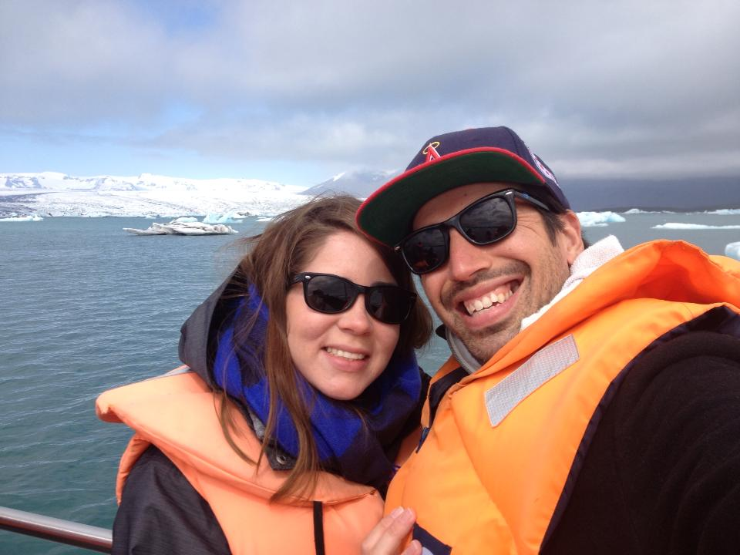
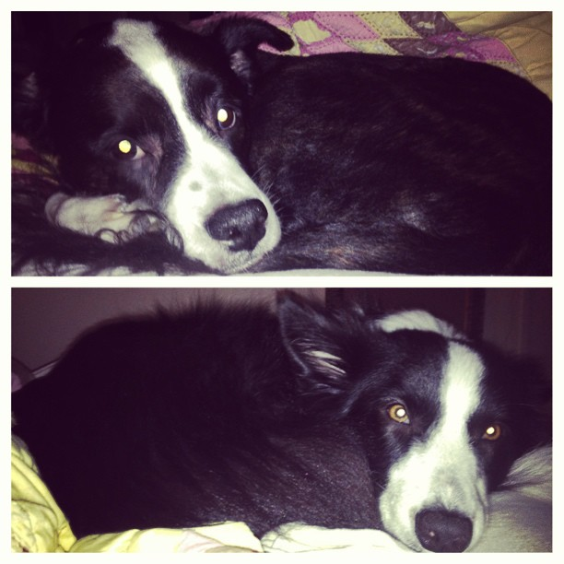
About Me!
Bachelors degree in Elementary Education
Masters degree in Educational Leadership
Married, three dogs: Koda, Cali, Kira
Canadian
Love to travel

Slide 3
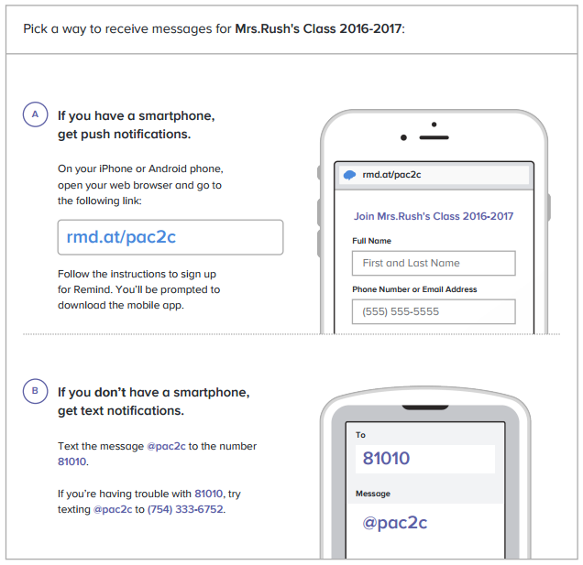
Want the most up to date
information and reminders?

Slide 4
Reminders
Class webpage
Clearwater.platoacademy.net
Back to school packet
Save for your reference.
Don’t forget to fill out the online form!

Slide 5
Reminders
Arrival
Students should be at school by 8:40
Students will be responsible for unpacking their supplies and getting ready for the day
Supplies
Bring all supplies 1st day of school
Write your students name on all supplies

Slide 6
Snack
We have an early lunch. To help the students focus in the afternoon, please send in a snack and water bottle each day.
Please label your child’s snack and water bottle.
Students will eat snack at 1:40.

Slide 7
Math & Reading homework help!
Download the Bounce Pages app!
Use your mobile device to snap a picture of the pre-tagged Pearson homework page, and an animation illustrating the page’s concept launches immediately.

Slide 8
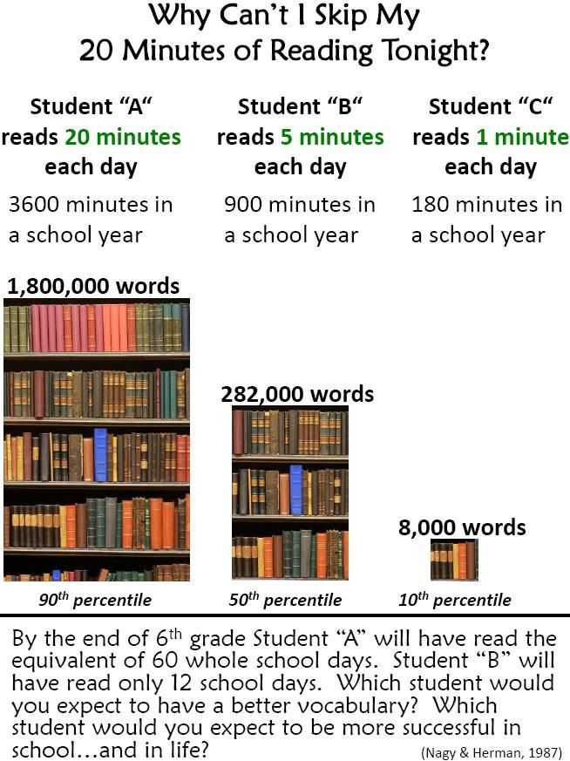
READ!

Slide 9
Carline Student Name Tags
You have two of them.
They MUST be displayed in your vehicle windshield to pick up your child.
ANYONE without the tags displayed will be IDed to verify permission to pick up.
Please let ME know if anyone other than people on the pick up list will be taking your child home.

Slide 10
Be sure to check out our class wish list on the way out!

Slide 11
Thank You!!!
For your help and support!
I am looking forward to a FANTASTIC year!

